Slide 1
System Design Using FPGAs

Slide 2
Laying down the objective:
FPGAs are inherently digital devices. We would design single slope ADCs using external comparator to create analog to digital convertor inside fpga.
To, present the output which is matched with the analog input we would use a RGB LED, whose intensity would define the given input analog voltage.
So, at the input we would be having four potentiometers to vary the analog voltage and at the output we would connect the RGB LED whose intensity will also be controlled, thus requiring four PWM outputs.

Slide 3
FPGA chip selected and its features:
Xilinx Spartan FPGA - XC3S50AN
In-system Flash memory of 1 Mb for storing non-volatile data
50k gates
176 CLBs
108 user IO pins
Can be programmed through JTAG(Joint Test Action Group) protocol

Slide 4
Beginning with Roti, Kapda, Makaan and Internet of our system.
The four basic requirements for the system would be:
Power Supply
System Clock
Reset, and
Ability to download program

Slide 5
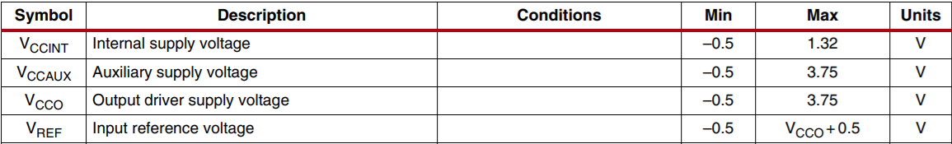
Power Supply
The power supply for the selected IC is divided into four groups, the below table taken from the datasheet shows the required voltage levels.

Slide 6
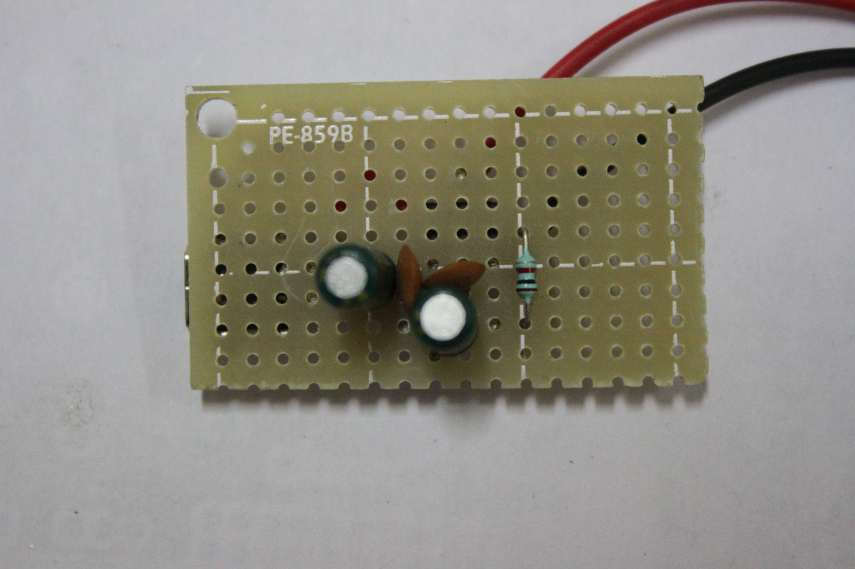
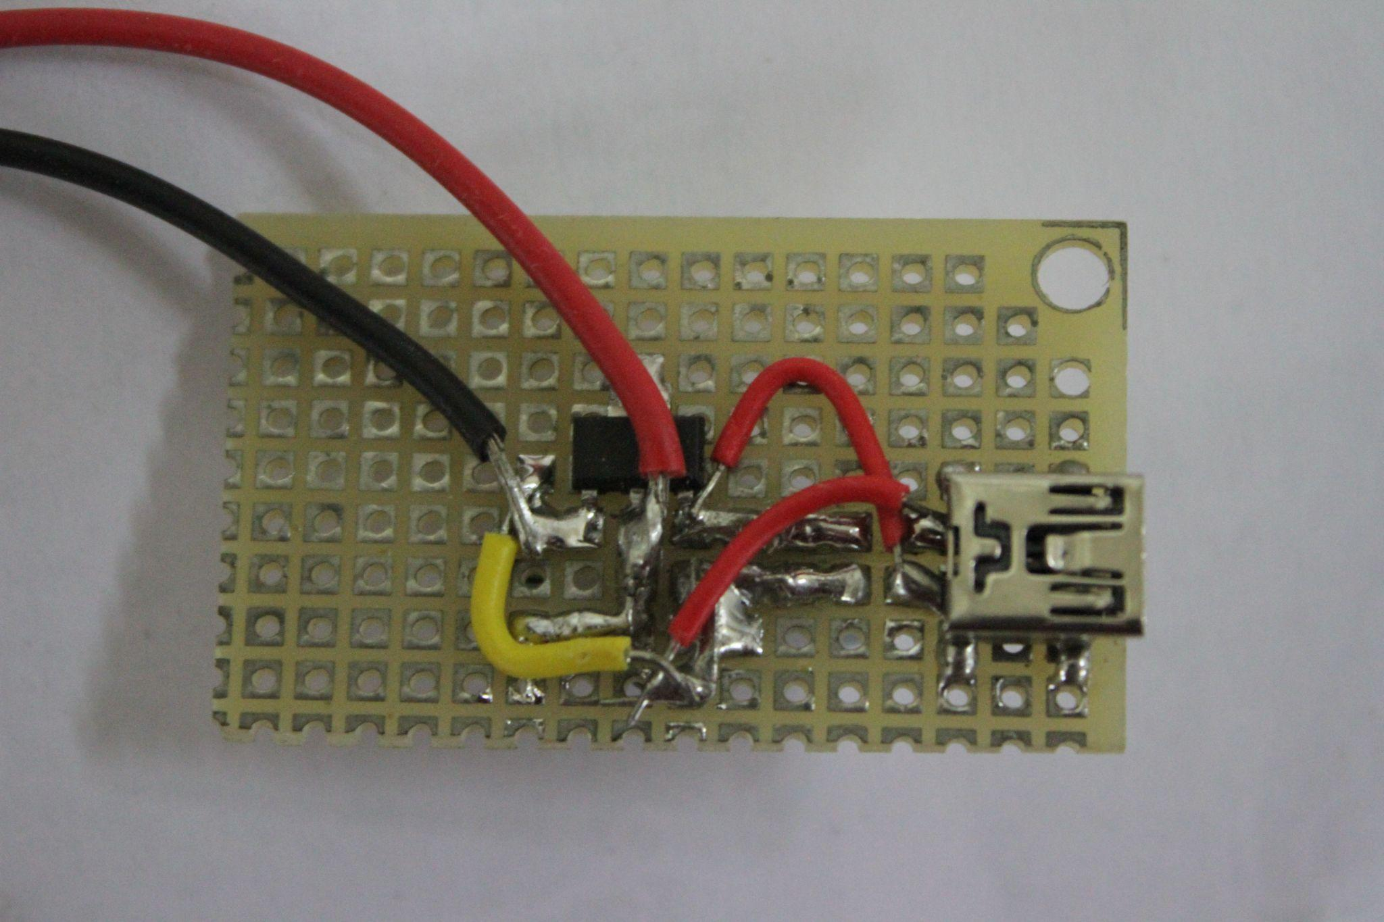
Making and testing of the power supply board
The power supply was designed using two linear regulators-
LM1117 - Fixed 3.3V output
LM1117 adj - Adjustable output voltage, configured to output 1.25V

Slide 7
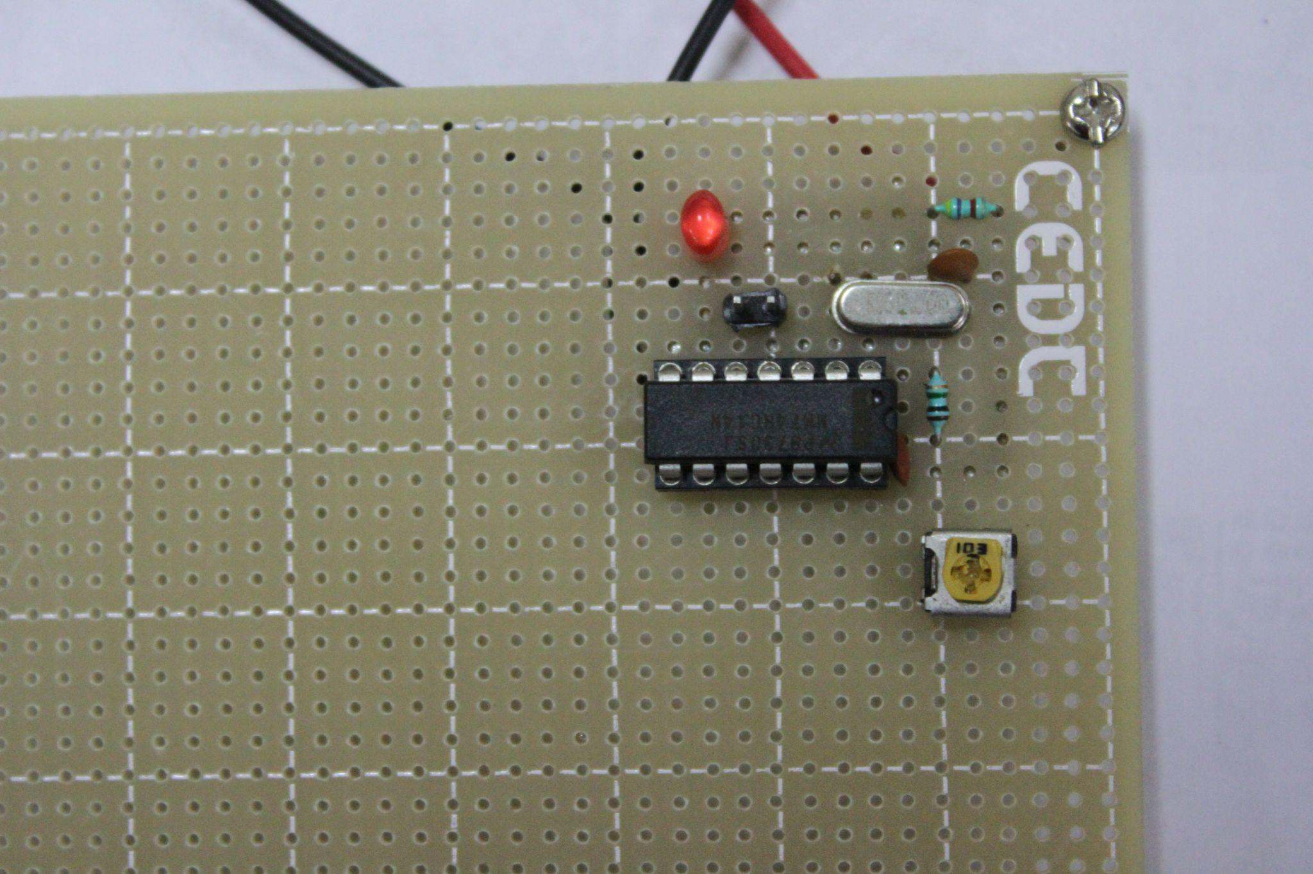
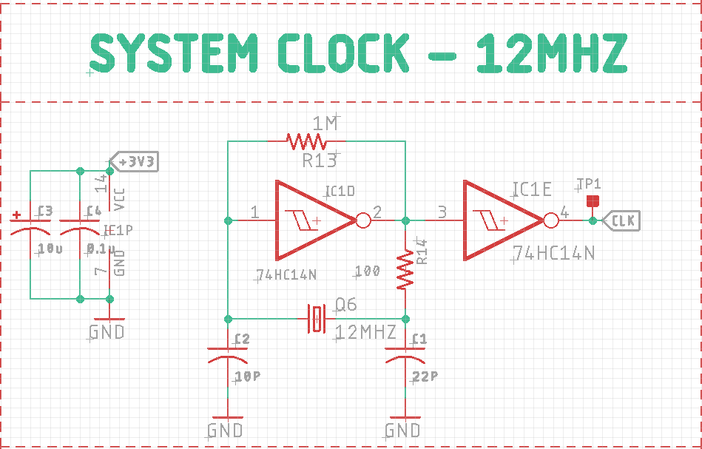
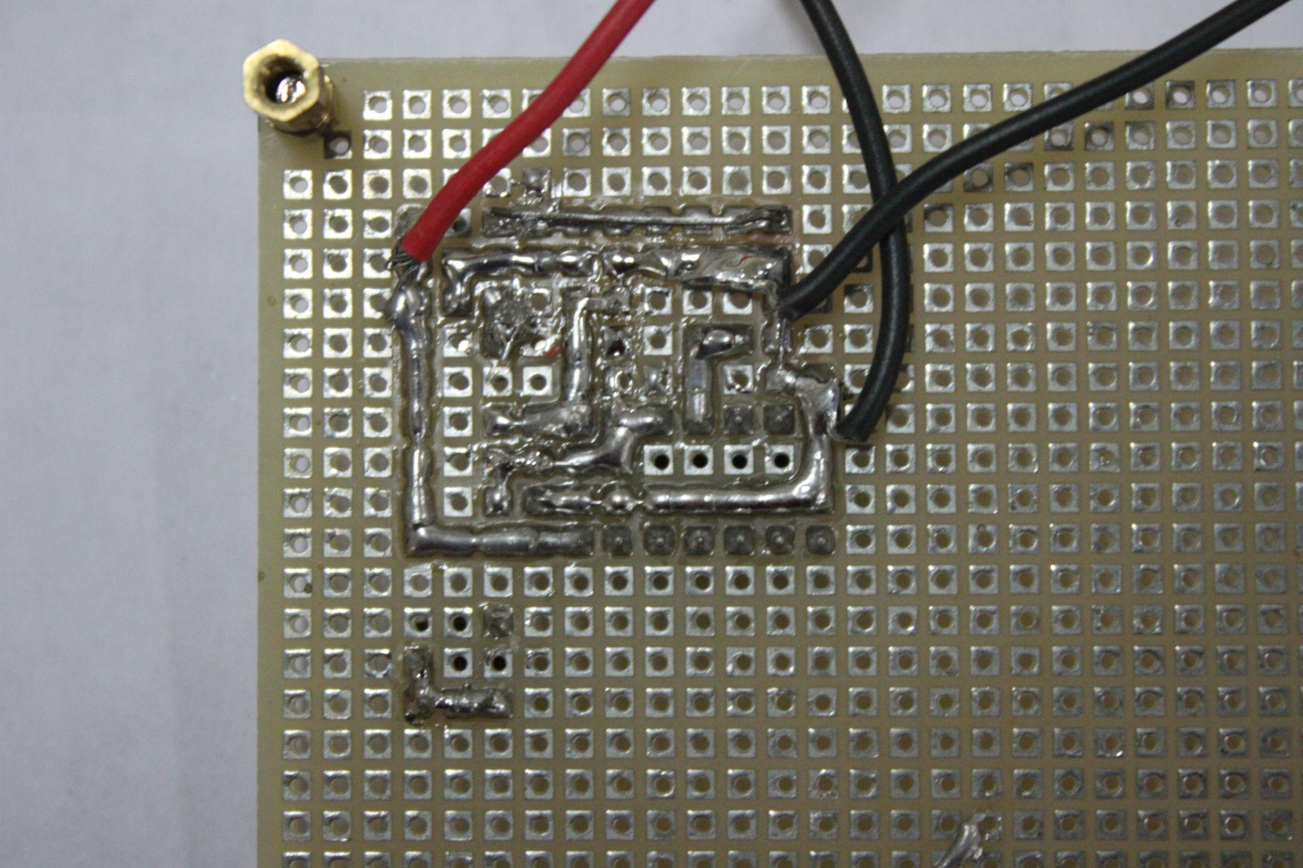
2. System Clock
The system clock of 12Mhz was designed using an oscillator and schmitt trigger IC 74HC14 and tested on zeroboard.

Slide 8
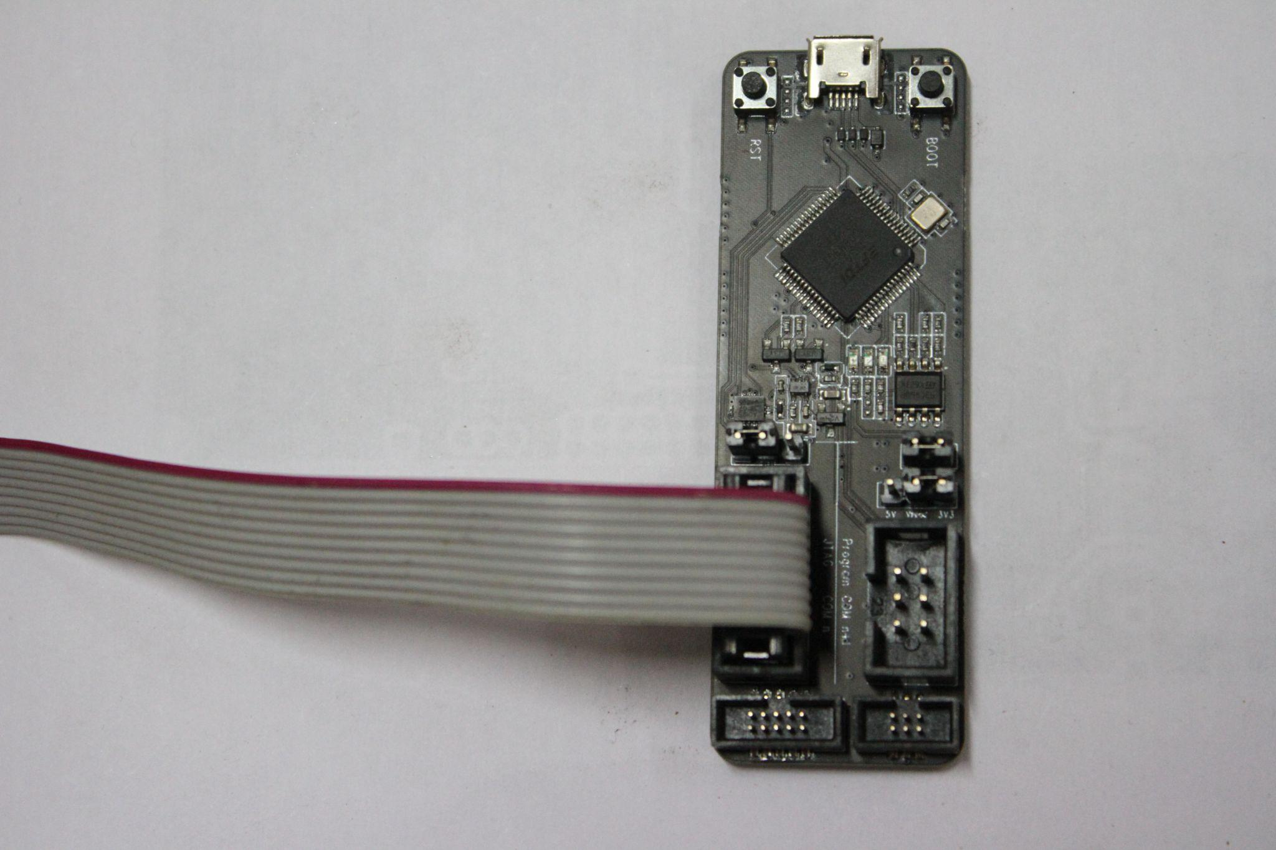
3. Program download Capability
The flash memory of the device can be programmed by the JTAG programmers. A separate PCB was made to test the programming of the device.
JTAG programmer used

Slide 9

4. Reset
Reset signal is given from a push-button on the final pcb and is incorporated in the state machine to reset the system.

Slide 10
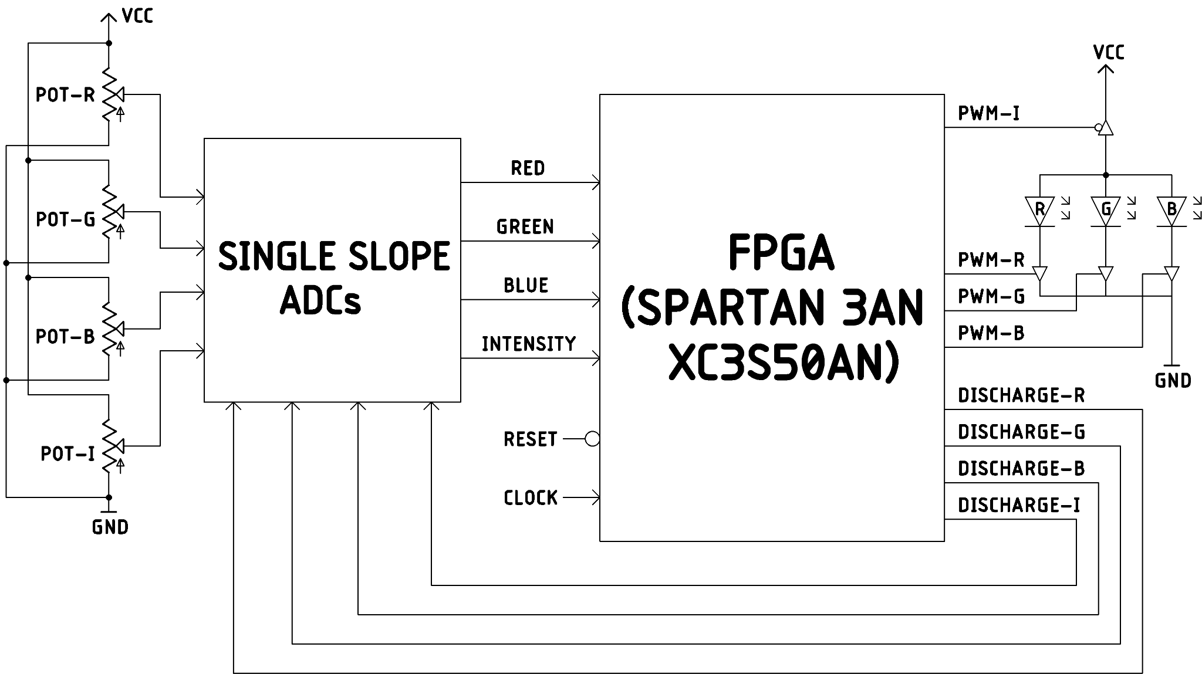
Block Diagram

Slide 11
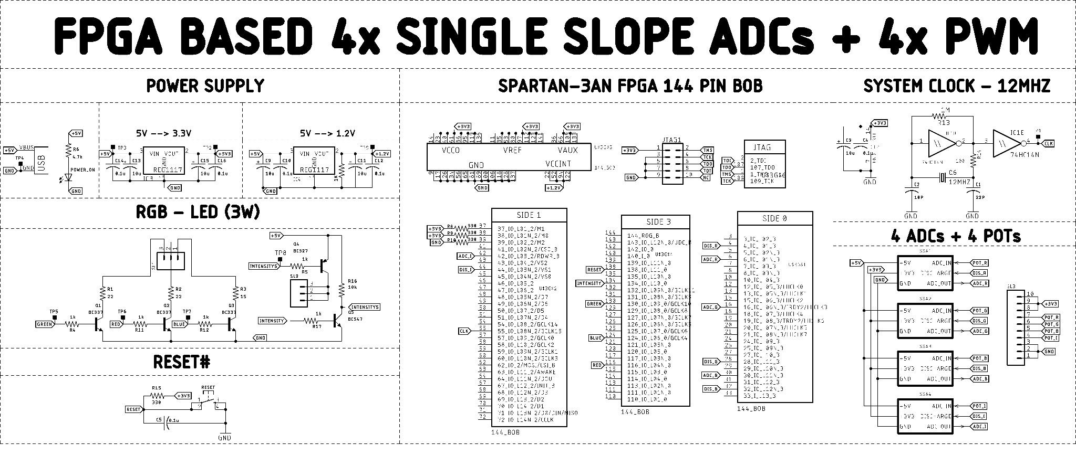
Compiled Schematic for the final board.

Slide 12
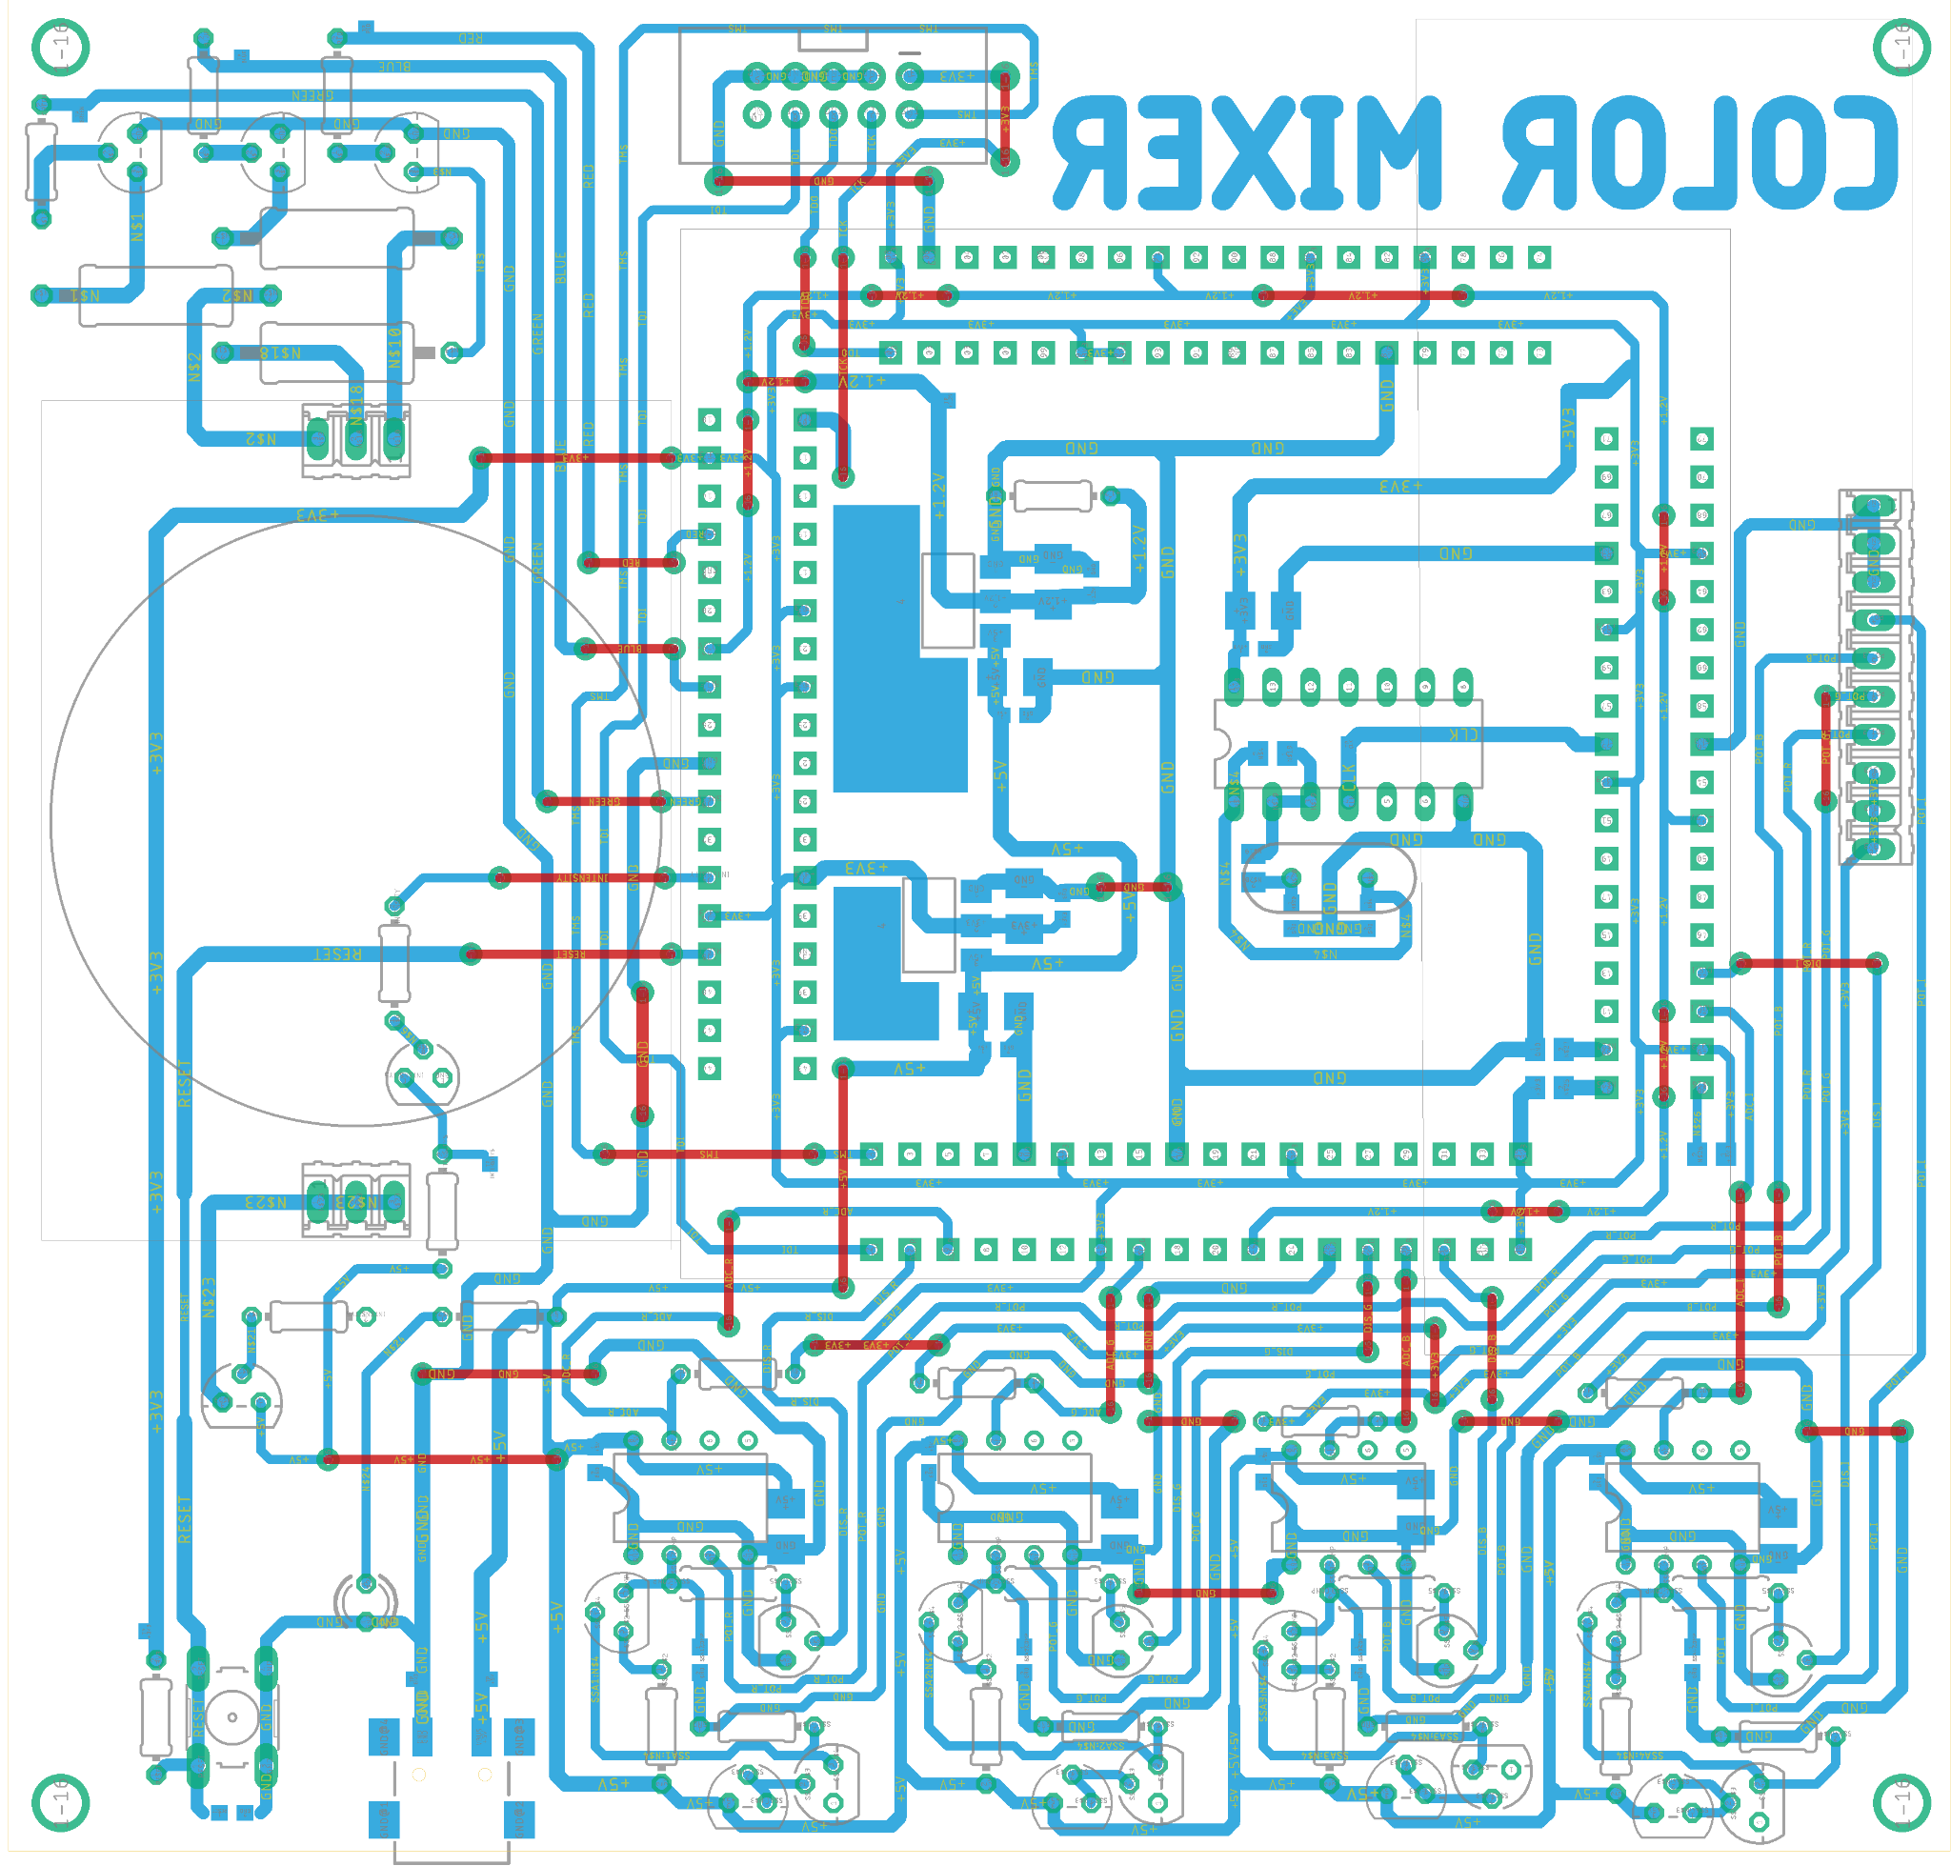
The board
layout

Slide 13
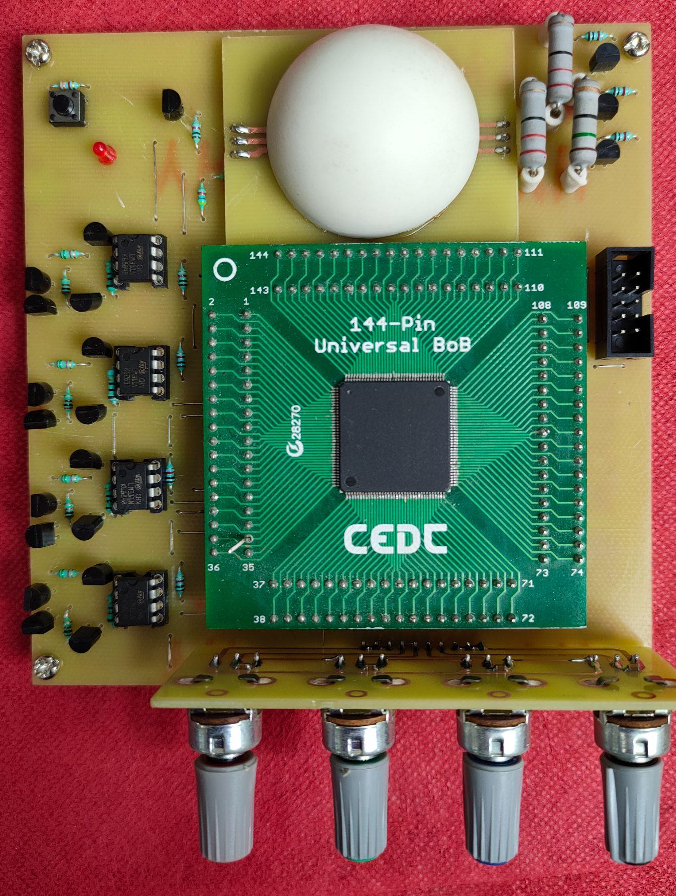
Fabricated and Soldered PCB

Slide 14
The Software part -
The program was written in verilog language using state machines.
https://prezi.com/view/Hx2WQj20rFkSAcaYVcmI/

Slide 15
Debugging and Testing

Slide 16
Thank You!

